Slide 1
Basic Biological Concepts
Lecture 4 – Biological Molecules
BIO 10 – Spring 2020

Slide 2
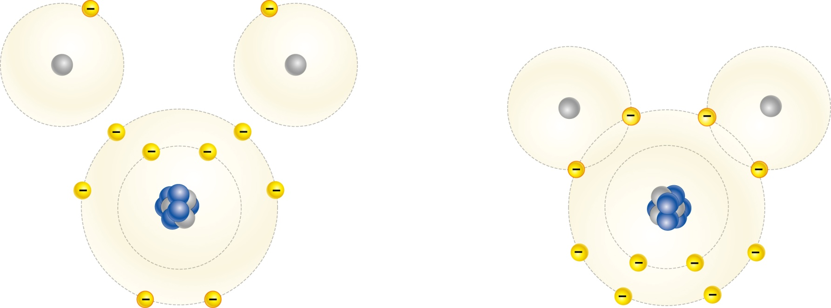
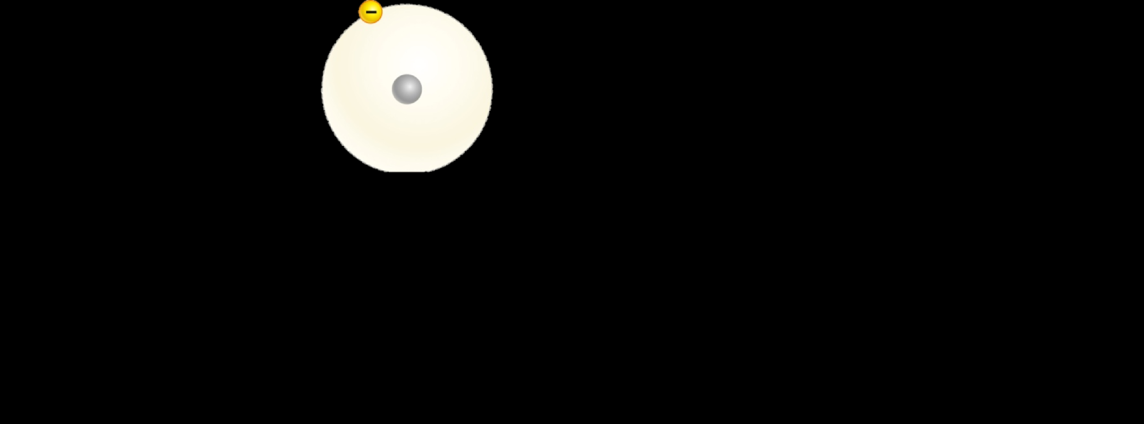
Water is the Most Fundamental Biomolecule
Life on Earth depends on the combining of two hydrogen atoms with one oxygen atom to form a water molecule (H₂O)
The three atoms are linked into a stable molecule by chemical bonds

Slide 3
Chemical Bonds Make Molecules!
Molecules are chemical substances made of two (or more) atoms linked together by chemical bonds
When unstable atoms interact with chemically matched partners they become more stable (less reactive) – this is generally the preferred state
There are three types of Chemical Bonds:
Covalent Bonds – atoms share electrons
Hydrogen Bonds – H⁺ ions are attracted to (-) charges
Ionic Bonds – atoms donate & accept electrons
Strength of bonds: Covalent > Ionic > H-bonds

Slide 4
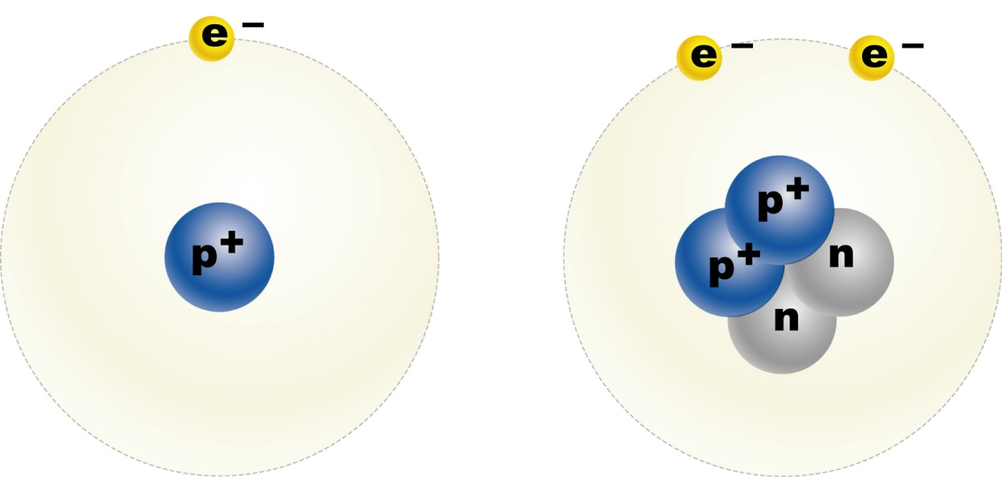
What are Atoms? Atoms are the smallest unit of all matter
Composed of 3 sub-atomic particles:
electrons (orbit the nucleus) negative charge (e-)
protons (nucleus)
positive charge (p+)
neutrons (nucleus)
no charge (n)
make the nucleus
In their common neutral state, atoms have equal numbers of protons and electrons

Slide 5
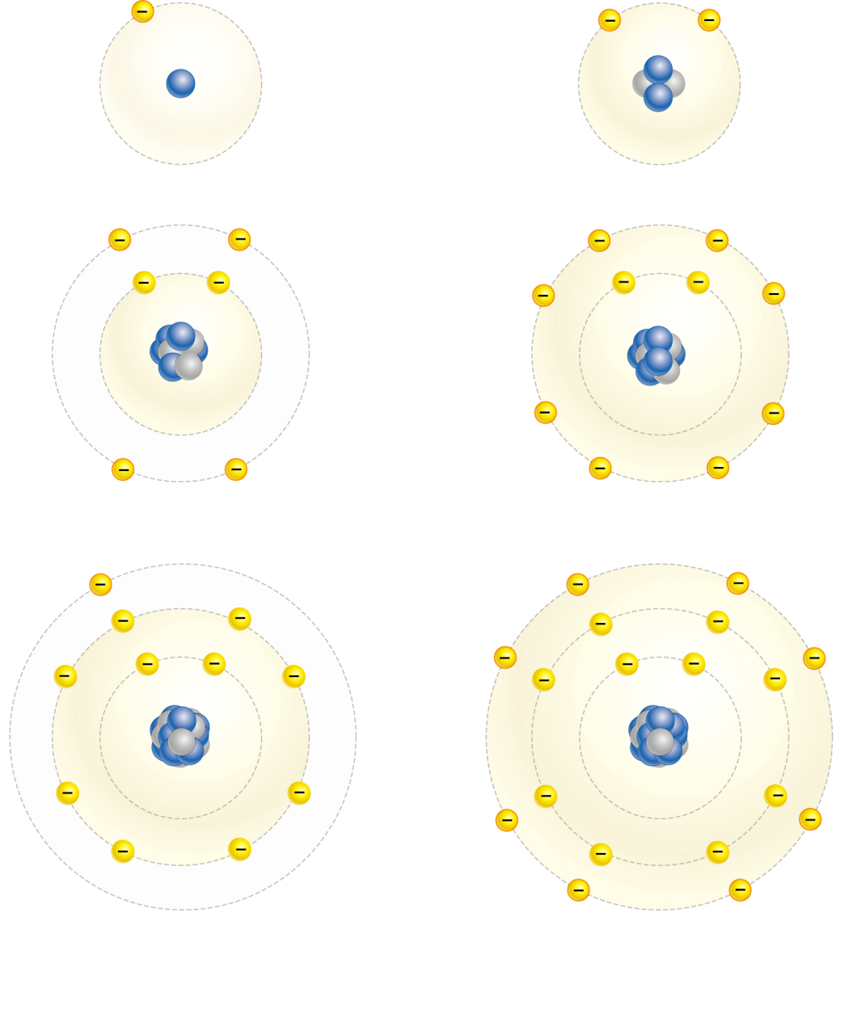
What Makes Atoms Stable or Unstable? Unfilled outer electron shells make atoms reactive (= unstable)
Electrons repel each other so they like a very regular distribution
Electron shells are the space where they orbit around the nucleus
The closest shell to the nucleus is full when filled with 2 e-
Each shell beyond that is full with 8 e-
The outermost shell (valence shell) determines the atoms stability – anything less than full is unstable
Argon is very stable
3 e- shells with 18 e-
2 + 8 + 8 = 18

Slide 6
The Atoms of Water Become More Stable through Strong, Covalent Bonds
Three unstable atoms
Three stable atoms
= One molecule of water
hydrogen (H)
1 Valence e-
hydrogen (H)
1 Valence e-
H₂O (Molecule of Water)
8 e- around O
2 e- around H’s
oxygen (O)
6 Valence e-
Covalent Bonds – the three atoms share their valence electrons

Slide 7
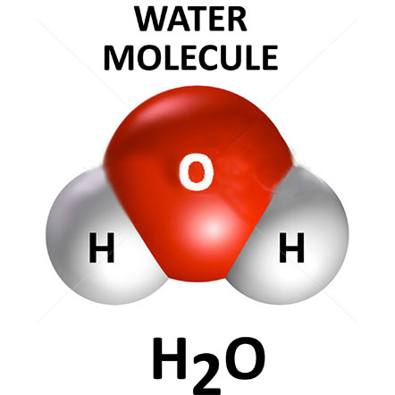
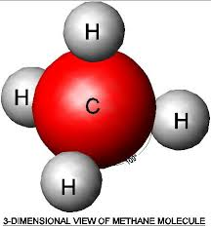
Covalent Bonds and Polarity: The Aqueous Environment
Water’s covalent bonds generate positive vs. negative charge “sidedness” to all water molecules
Polarity = e- are not shared equally between the two atoms
In water molecules all e- are closer to O atom than to H atoms
Water molecules have small negative charges at one side and small positive charges at the other side
Polar molecules vs. non-polar molecules
Water
Methane
(+)
(-)
Polar molecules - molecule has
a “sidedness” of charge
(-)
(+)
(+)
(+)
Non-polar molecules – there is no
“sidedness” of charges, they are symmetric
(+)
(+)
(+)

Slide 8
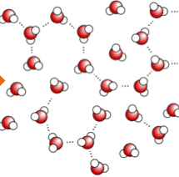
Types of Chemical Bonds: Hydrogen Bonds (2)
Hydrogen bonds – attractions between the polar regions of molecules
Polar molecules act like tiny magnets and are physically attracted to each other
Bonds form between the (+) charges and (-) charges of neighboring molecules
No e- are transferred or shared!
(-)
(+)
(+)

Slide 9
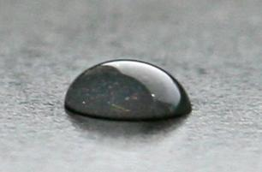
Hydrogen Bonds
Water is the most abundant polar molecule in Planet Earth
Hydrogen (H) bonds hold water molecules together making drops
H-Bonds are very weak individually, but strong when lots present

Slide 10
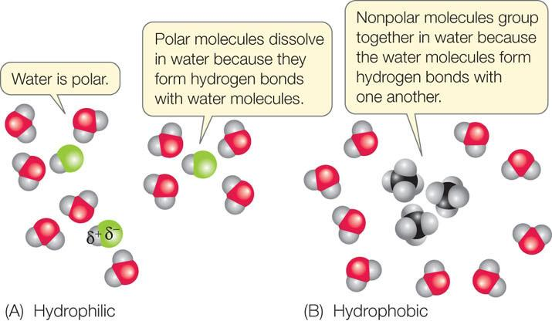
Because the Earth and its inhabitants all exist in an aqueous state this dominates Earth’s biochemistry

Slide 11
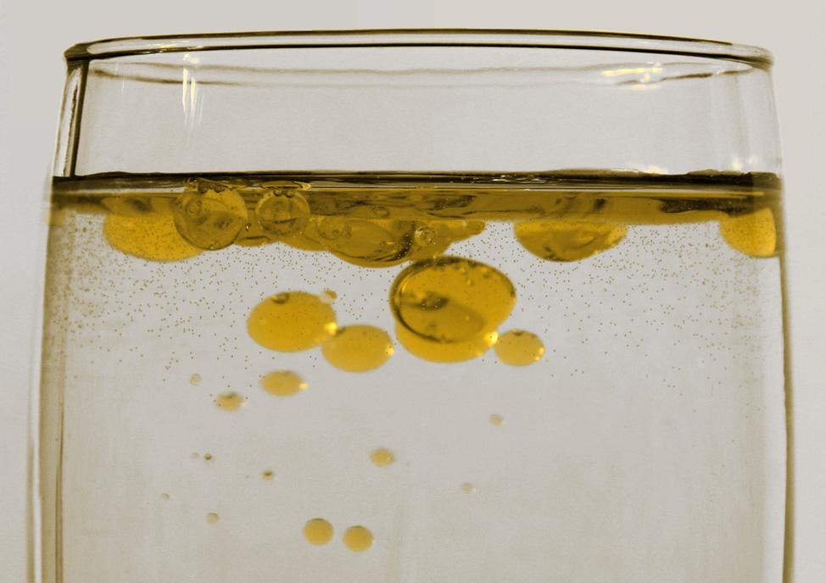
Hydrophilic and Hydrophobic Molecules
Hydrophilic Molecules = polar molecules; act like magnets towards each other and water
Water “loving” molecules!
Hydrophobic Molecules = non-polar molecules; act like magnets towards other non-polar molecules
Water “fearing” molecules
Hydrophilic molecules and Hydrophobic molecules are NOT attracted to each other (repel each other)
“Like attracts like”
Water and Oil do not mix!
Water is polar (hydrophilic) and Oil is non-polar (hydrophobic)
Hydrophobic molecules get pushed away from hydrophilic molecules

Slide 12
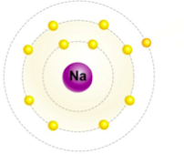
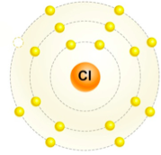
Types of Chemical Bonds: Ionic Bonds (3)
Another way to achieve atom stability is for an atom(s) with a small number of extra valence e- to transfer them to an atom(s) with too few valence e- of the same number.
sodium (Na) atom
(11e- and 11p+)
1 valence e-
chlorine (Cl) atom
(17e- and 17p+)
7 valence e-
electron transfer
sodium (Na⁺¹) ion
(10e- and 11p+)
8 valence e-
Cation = ion with more p+ than e-
Ion has + charge
chlorine (Cl⁻¹) ion
(18e- and 17p+)
8 valence e-
Anion = ion with more e- than p+
Ion has - charge

Slide 13
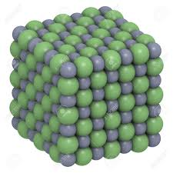
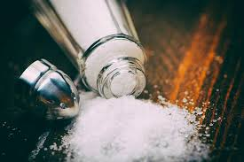
Types of Chemical Bonds: Ionic Bonds (3)
After e- are transferred both atoms are stable but now carry opposite charges
Sodium lost an electron to become positively charged because it has one unmatched proton
Chlorine gained an electron to become negatively charged
Opposite charges attract and the molecule sodium chloride is formed
Blue sodium atoms
Green chloride atoms
Notes:
Are the atoms stable?

Slide 14
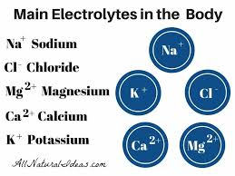
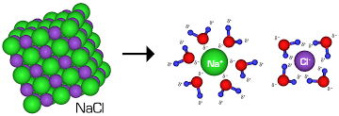
Remember: Earth and its Cells are Aqueous
Charged Ions readily dissolve in polar water!

Slide 15
Biological Macromolecules
There are four general classes of large biomolecules:
Carbohydrates
Nucleic acids
Proteins
Lipids
With the exception of lipids, all the classes of biomolecules use monomers (subunits) to build polymers (chains)
monomer
polymer

Slide 16
Organic molecules are those found in and created by living organisms
95% of all organic molecules are made from just 5 atoms:
hydrogen (H)
oxygen (O)
nitrogen (N)
carbon (C)
phosphorous (P)
Each atom is able to make
a certain number of bonds
Organic molecules are built
upon a carbon “backbone”
H
O
N
1
2
3
C
P
4
5 (not very stable)

Slide 17
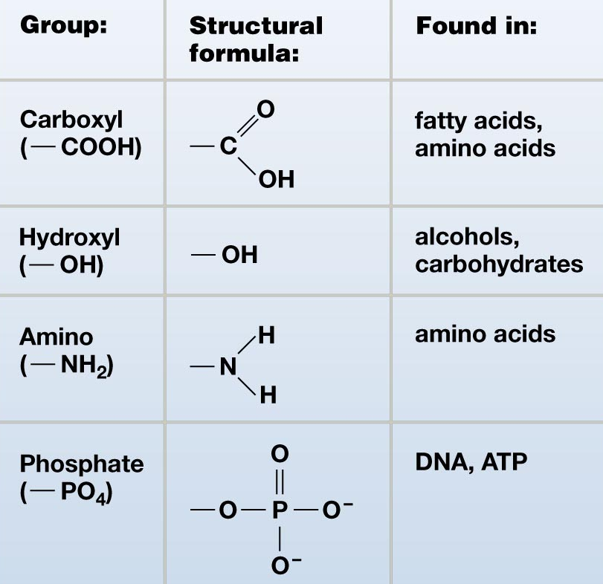
Groups of atoms known as functional groups can give special properties to carbon-based molecules.
Example:
Addition of an –OH group to a
hydrocarbon chain results in an alcohol
C
C
C
C
O
H
ethane
ethanol

Slide 18
Carbohydrates
Carbohydrates are saccharides (sugars)
Carbohydrate monomers are simple sugars called monosaccharides
The three most common monosaccharides are:
glucose – “blood sugar”
galactose – found in milk
fructose – found in honey

Slide 19
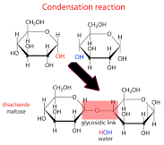
Two monosaccharides linked together form a disaccharide
Examples:
glucose
galactose
fructose
lactose
sucrose
maltose
More than two monosaccharides linked together form a polysaccharide
Polysaccharides are also known as complex carbohydrates

Slide 20
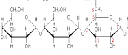
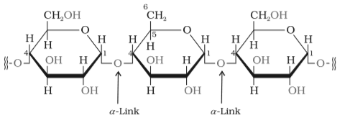
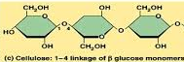
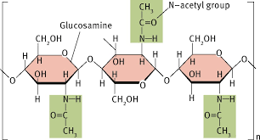
There are four common types of polysaccharides:
Glycogen – used by animals for energy
Starch – used by plants for energy storage
Cellulose – used by plants for structure
Chitin – used by arthropods for exoskeleton

Slide 21
Nucleic Acids: RNA and DNA
Nucleic acids are polymers made from nucleotide monomers
Each nucleotide monomer has 3 parts:
base
phosphate group
P
ribose
(sugar)
Ribose in DNA has an oxygen removed (deoxyribose)
Bases in DNA: adenine (A), thymine (T), cytosine (C), guanine (G)
Bases in RNA: adenine (A), uracil (U), cytosine (C), guanine (G)

Slide 22
Nucleotides can be linked together to form long chains of DNA (deoxyribonucleic acid) or RNA (ribonucleic acid)
The sugars and phosphate groups link together to form the “backbone”
The nucleotide sequence gives the nucleic acid its unique information carrying capacity
The nucleotide sequence can be translated into the language of proteins
The nucleotide sequence allows DNA to bind into its characteristic double helix

Slide 23
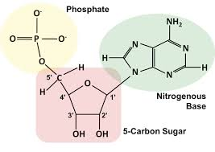
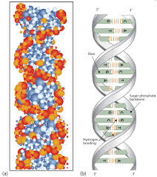
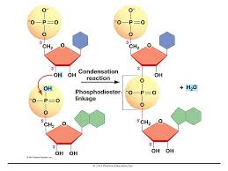
Chemical Bonds in Nucleic Acids
All of the bonds in each nucleotide are covalent
In the DNA double helix the two strands are joined by hydrogen bonds.
2 H bonds between A and T,
3 H bonds between C and G
Sugar-phosphate bonds are covalent and result from the removal of a water molecule
The many charges on DNA, particularly those of the phosphate groups in the backbone, make nucleic acids polar and they readily dissolve in water

Slide 24
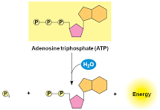
Adenosine triphosphate (ATP) is a special nucleotide
ATP is used to power nearly every function of our bodies
ATP is created by adding a phosphate to adenosine diphosphate (ADP)
This is accomplished by substrate-level phosphorylation in the cytosol and oxidative phosphorylation in the mitochondria
It takes energy to attach the third phosphate group, which is released when the bond is broken and used for power
A
P
P
P

Slide 25
Protein Biochemistry
Proteins are the molecules that do stuff...
Build new molecules, digest food, pump blood, move limbs, signal other cells, transport substances, create new cells, etc.
Proteins also provide structure...
Give cells their shape
Contribute to the structures outside the cell that hold multicellular organisms upright
Hair, fingernails, feathers, scales all made from protein

Slide 26
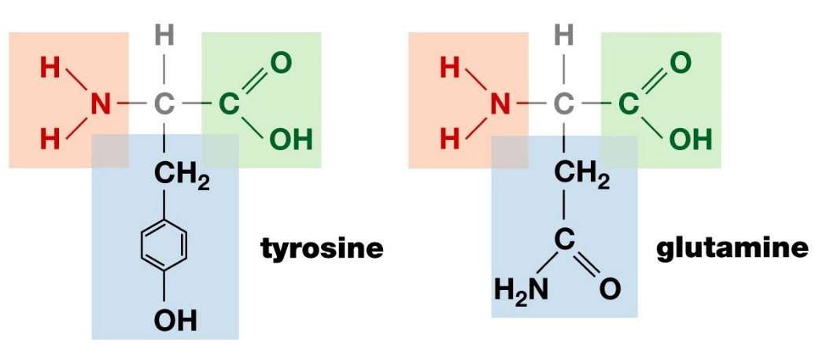
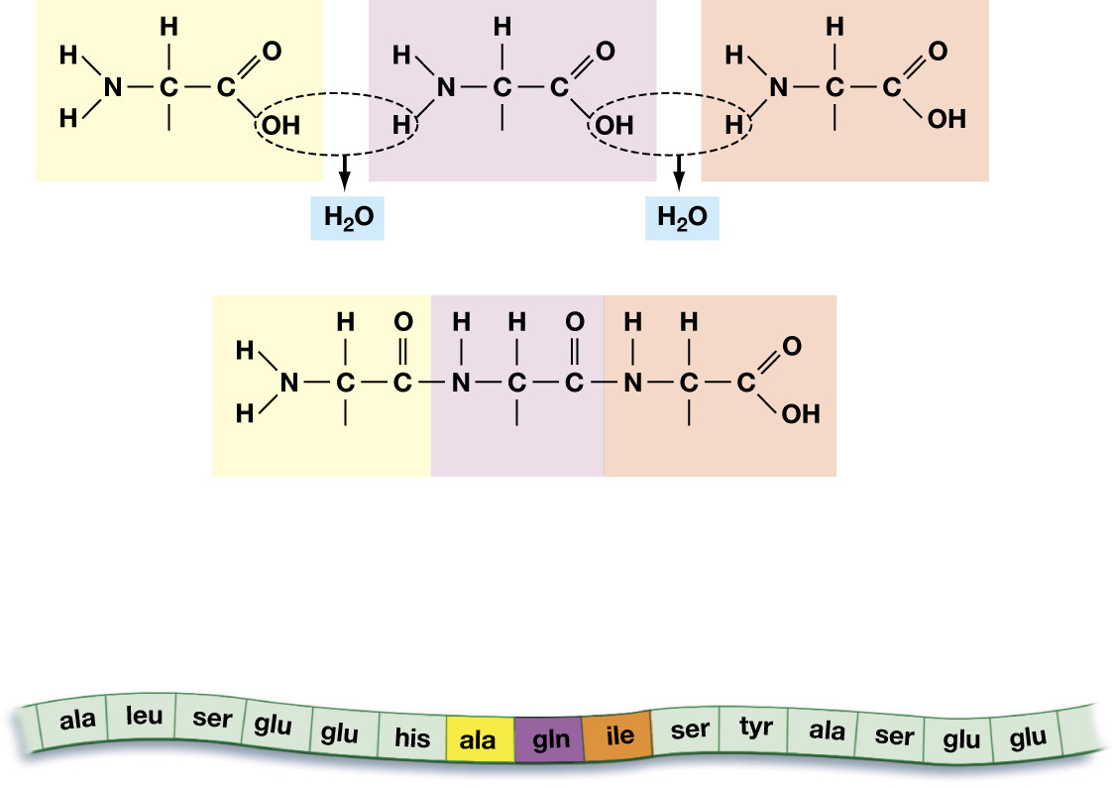
Proteins are long chains of amino acids (a.a.) that are linked together by covalent bonds
a.a
a.a
a.a
a.a
a.a
a.a
a.a
a.a
amino acid
protein
R
R
R
The only difference between a.a. are the side chains (R)
Some are hydrophilic, some hydrophobic which gives us ability to build anything!
R
R
R
Dehydration (condensation) forms peptide bonds, hydrolysis breaks, eg. digests, them

Slide 27
In adult humans...
11 of the 20 amino acids can be made by the body
called non-essential a.a.
9 of the 20 amino acids cannot be made by the body
called essential a.a.
must be found in the diet

Slide 28
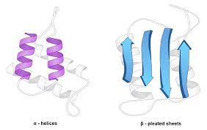
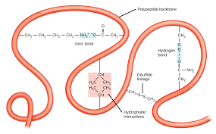
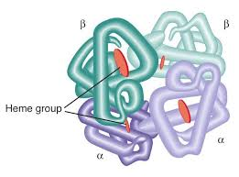
Protein Structure
Primary Structure = the sequence of amino acids in the chain
Secondary Structure = As a protein is created and grows, a.a. side chains interact non-covalently giving the protein shapes, such as alpha helices, B-pleated sheets
Tertiary Structure =
Quaternary Structure = the association of several protein chains or subunits into a closely packed arrangement. ... The subunits are held together by hydrogen bonds and van der Waals forces between nonpolar side chains

Slide 29
A protein’s shape determines its functionality
Protein shape is affected by temperature and pH (acidity)
This is why heat kills cells

Slide 30
Lipid Biochemistry
Lipids are hydrophobic (non-polar)
Are made nearly entirely from carbon (C) and hydrogen (H)
Include:
Triglycerides (fats and oils)
Phospholipids
Cholesterol (steroids)
Waxes

Slide 31
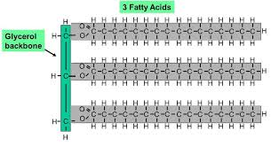
1. Triglycerides:
Used for:
energy storage
thermal/mechanical insulation (in animals)
At room temperature they can be liquids (oils) or solids (fats)
Structure: 3 free fatty acids attached to a glycerol molecule

Slide 32
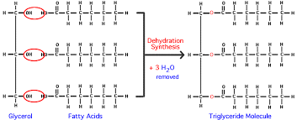
Covalent bonds formed between each carbon of glycerol and 3 fatty acids through removal of water.
Digestion of dietary triglycerides and use of fats for energy requires putting the water back (hydrolysis)
Triglycerides are non-polar and separate from water in an aqueous environment

Slide 33
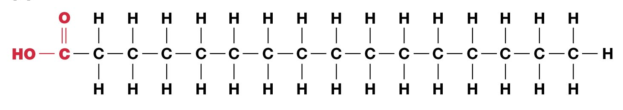
A free fatty acids is a long carbon-hydrogen chain with a carboxyl group at one end
Free fatty acids come in three types:
Saturated
Monounsaturated
Polyunsaturated
“Saturated” = saturated with hydrogen atoms

Slide 34
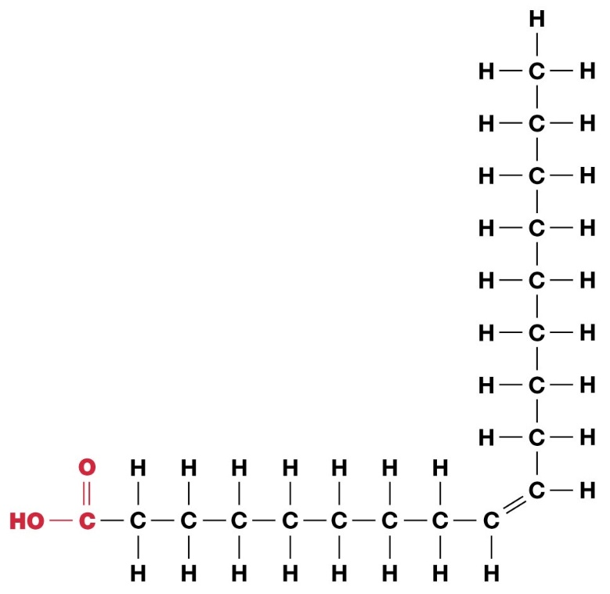
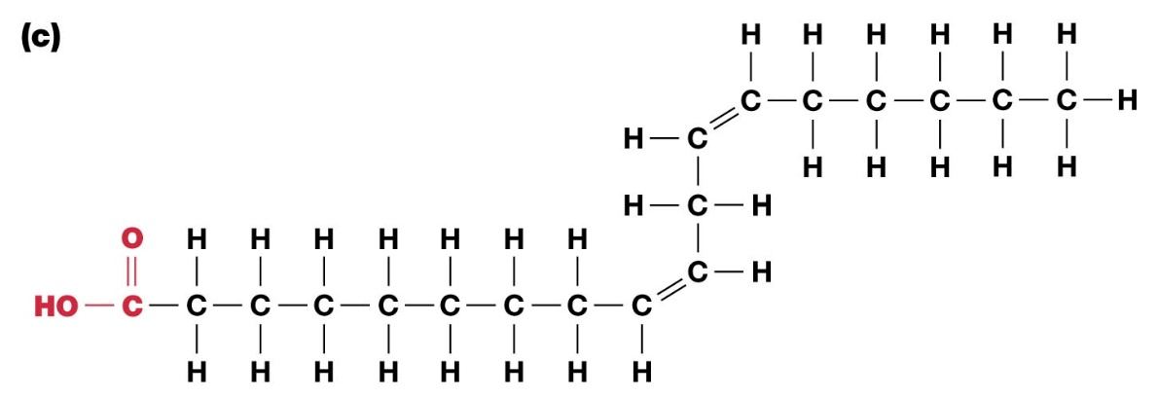
Saturated fats have as many hydrogen atoms as will fit onto the carbon atoms
Monounsaturated fats have a single carbon double-bond allowing for less hydrogen atoms
Polyunsaturated fats have several carbon double-bonds allowing for even less hydrogen atoms

Slide 35
Saturated fats
Least healthy
Solid at room temperature
Polyunsaturated fats:
Most healthy
Liquid at room temperature

Slide 36
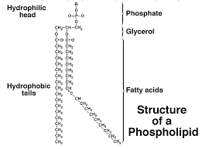
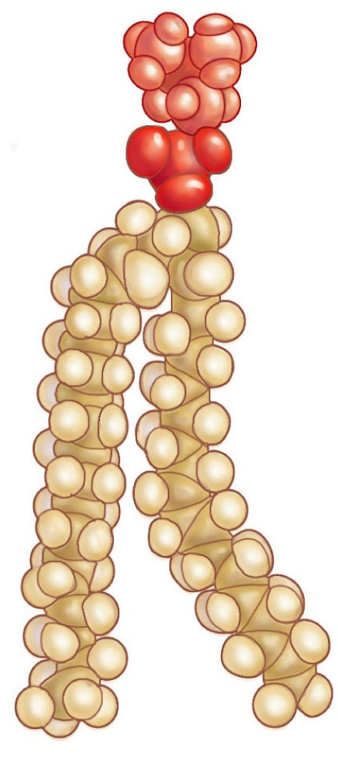
Phospholipids are modified triglycerides
Used in cell membranes

Slide 37
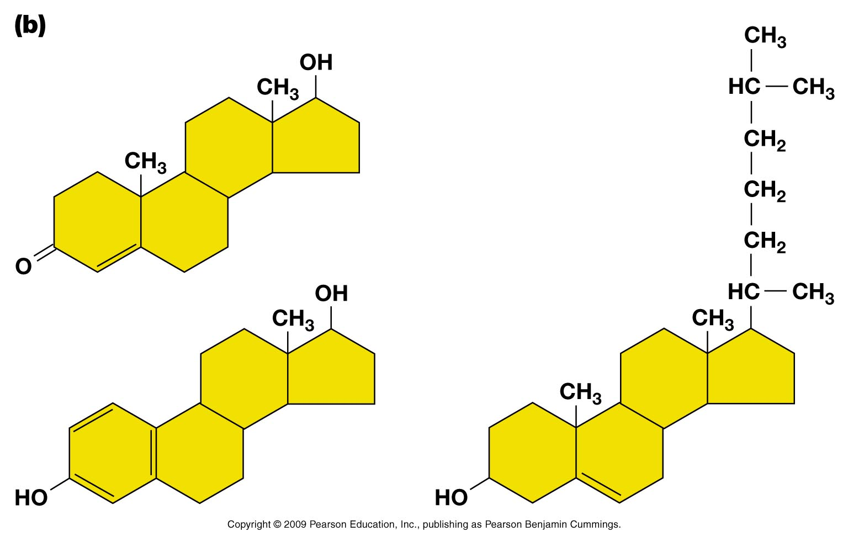

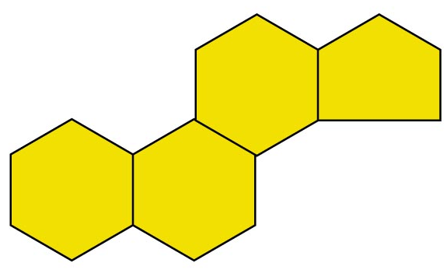
Steroids:
Cholesterol – used in cell membranes
Steroid hormones – chemical signals
Steroid structure:
4 carbon rings with various functional groups
Estradiol
(estrogen)
Steroid Backbone
Cholesterol
Testosterone

Slide 38
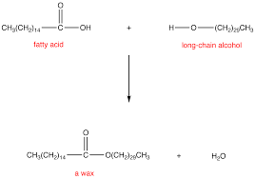
Waxes…
Thin layer of fatty constituents that cover the leaves of plants or provide a surface coating for insects or the skin of animals
Used as a sealant by plants to protect against dehydration and small predators
Used by animals as a water repellant
Produced by specialized cells or glands
Made of wax esters, i.e. esters of long-chain fatty alcohols with long-chain fatty acids

